Slide 1
Title: Insurance Model Deployment: Predicting Attorney Involvement
Subtitle: Data Science Project Overview
Team:
Katepogu Darshith Raj
Tirumala setty Liteesh Kumar
Kakade Chetan
Mohamed Ismail

Slide 2
Project Overview:
Objective:
To predict whether an insurance claim involves an attorney based on claim details
Dataset:
1340 rows, 13 columns.
Features include: Claimant Age (CLMAGE), Loss Amount (LOSS), Claim Amount Requested, Accident Severity, etc.
Tools used:
Python
Jupyter Notebook
Streamlit

Slide 3
Exploratory Data Analysis (EDA):
Key Insights:
Distribution of ATTORNEY: Balanced between 0(No Attorney) and 1 (Attorney Involved).
High correlation observed between Loss and Claim Amount Requested.
Null values identified in features like CLMAGE and SEATBELT.
Visualizations:
Distribution charts for categorical variables.
Correlation heatmap for numerical features

Slide 4
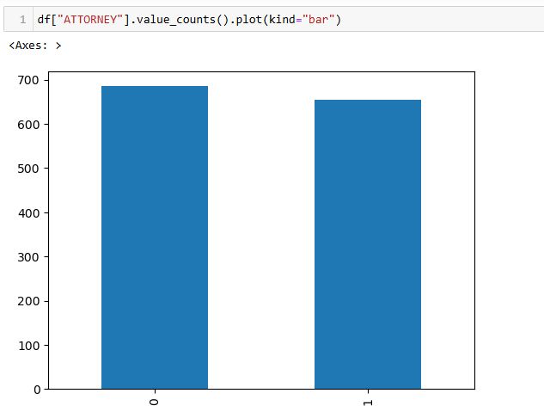
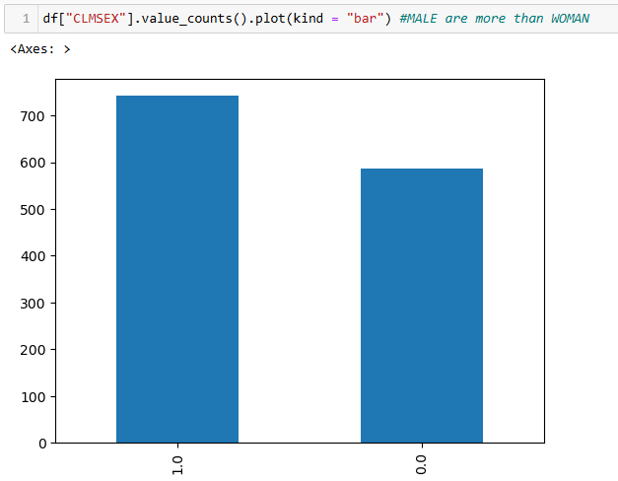
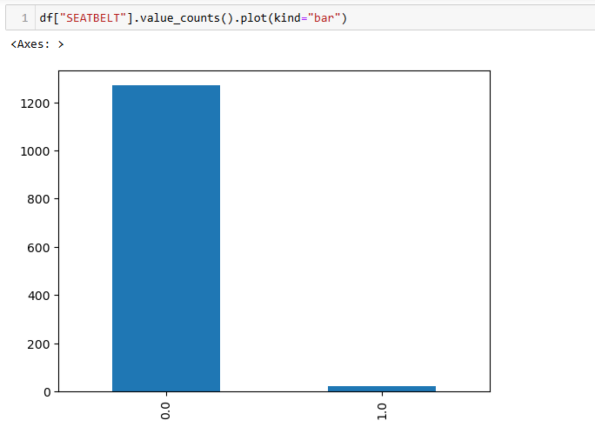
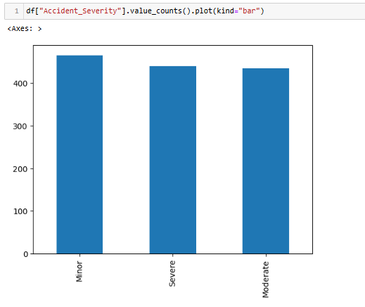

Slide 5
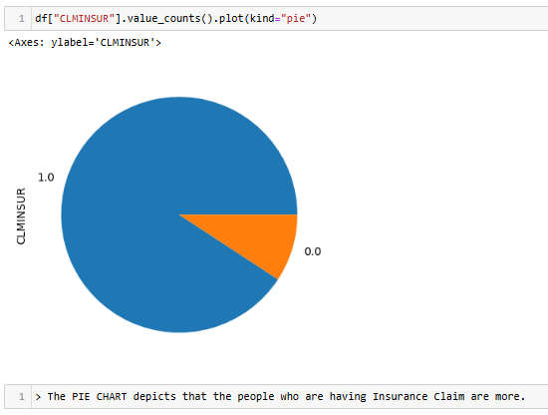
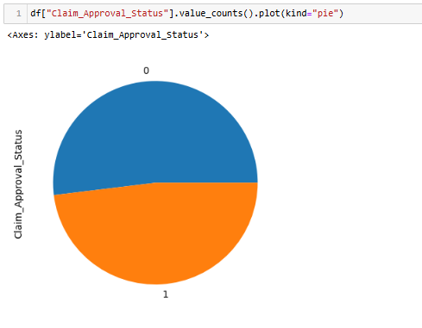

Slide 6
Data Processing:
Steps taken:
Imputed missing values:
CLMAGE: Median imputation.
SEATBELT: Mode imputation.
Encoded categorical variables using one-hot encoding.
Scaled numerical variables using StandardScaler to manage outliers.
Outcome:Cleaned and transformed dataset ready for modeling.

Slide 7
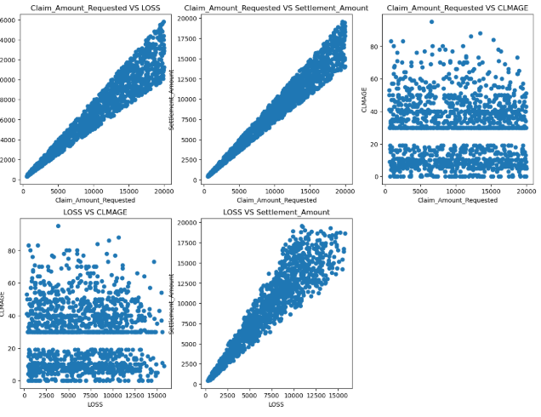

Slide 8
Model Building:
Models Tested:
Logistic Regression
Decision Tree Classifier
Random Forest Classifier
Gradient Boosting
XGBoost
Performance metrics:
Accuracy scores ranged from ~50% to 57%.
Gradient Boosting and XGBoost showed the best results.

Slide 9
Model Evaluation:
Results:
XGBoost:
Accuracy: 57% (best model).
Hyperparameter tuning improved performance.
Gradient Boosting:
Accuracy: 55%.
Iteratively refined errors for robust predictions.
Visualizations:
Confusion Matrices for comparison.
ROC-AUC curves demonstrating model performance.

Slide 10
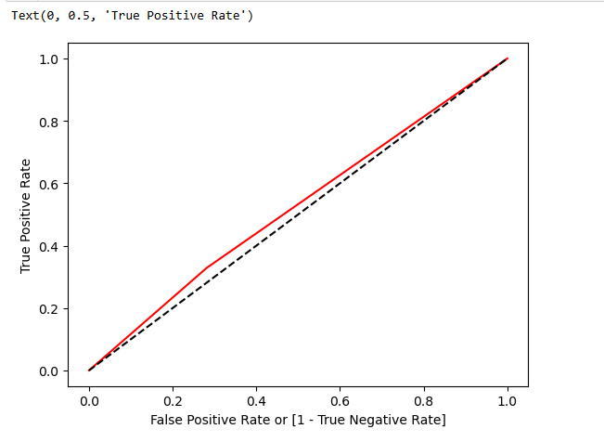

Slide 11
Model Deployment:
Deployment tool:Streamlit
App Features:
User inputs: Claimant Age, Loss Amount, Claim Amount Requested, Accident Severity.
Prediction output: Attorney Involved or Not.
Feature importance visualization.
Implementation:
Model file used: grid_search_xgb.joblib
Interactive web application deployed locally.

Slide 12
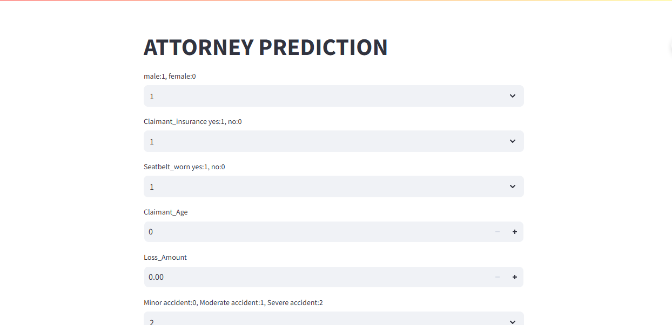

Slide 13
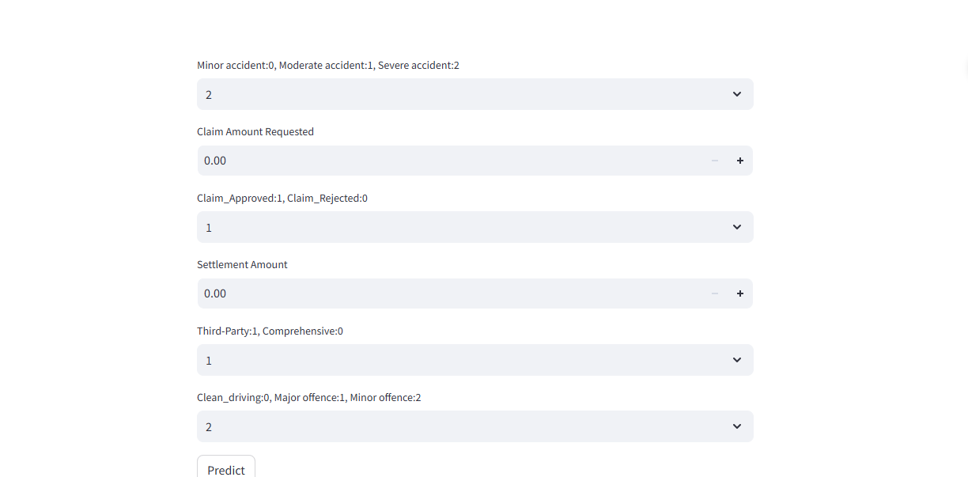

Slide 14
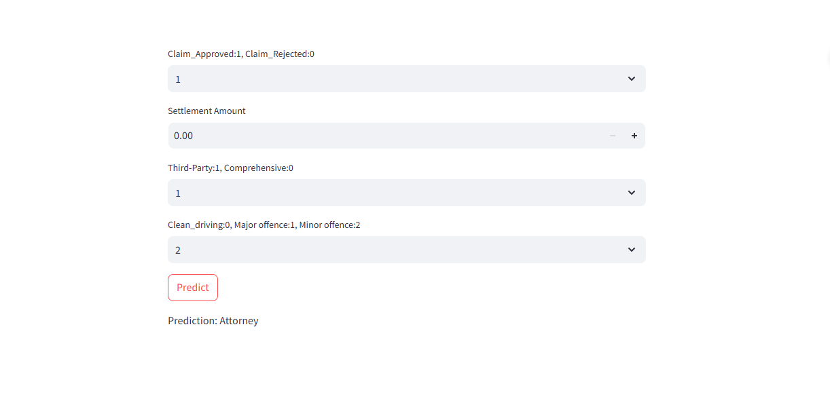

Slide 15
Challenges & Learnings:
Challenges:
Handling missing values without impacting prediction quality.
Setting up Streamlit for deployment.
Learnings:
Importance of hyperparameter tuning for improved accuracy.
Effective feature engineering techniques.

Slide 16
Future Improvements:
Introduce new features for enhanced predictive power.
Experiment with advanced ensemble models.
Incorporate external datasets for additional context.

Slide 17
THANK YOU FOR YOUR ATTENTION!

